Slide 1
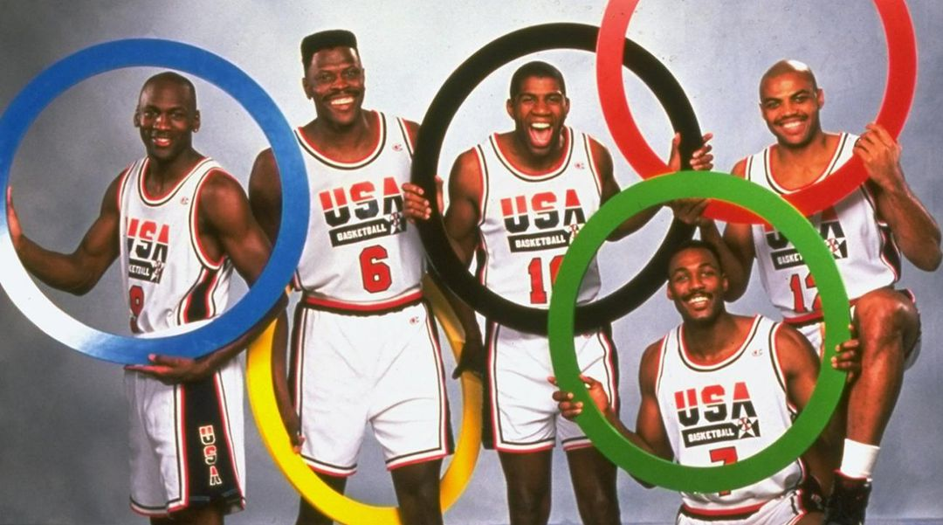
120 Years
of Olympics History
The Scheme Team
Junette, Michael, and Alli

Slide 2
Overview
We started with 120 years of Olympic data — 271,000 rows that documented every athlete by his or her respective events for both the Summer and Winter Olympics since 1896
We used Pandas, Python, SQLite, a Flask App, HTML, CSS, and JavaScript to bring our data from a CSV to a user-controller dashboard
We built our dashboard using d3 and chart.js and created user inputs to filter results by year and country

Slide 3
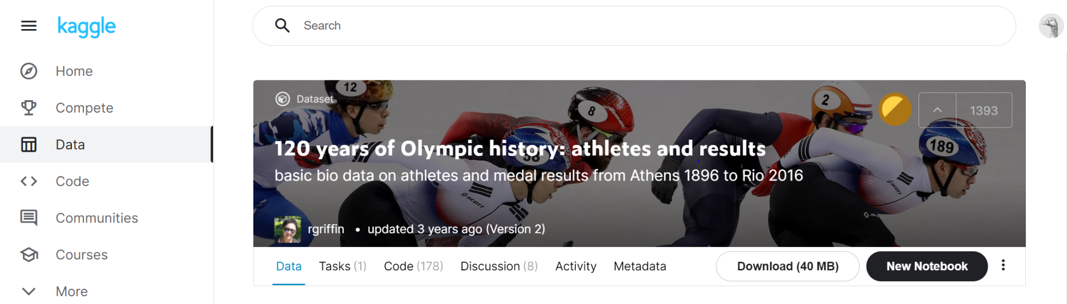
Our Data
ID - Unique number for each athlete
Name - Athlete's name
Sex - M or F
Age - Integer
Height - In centimeters
Weight - In kilograms
Team - Team name
NOC - National Olympic Committee
Games - Year and season
Year - Integer
Season - Summer or Winter
City - Host city
Sport - Sport
Event - Event
Medal - Gold, Silver, Bronze, or NA
Country name
We used two CSV files from Kaggle — one with Olympic history, and the other with Olympic National Committees mapped to geographic regions

Slide 4



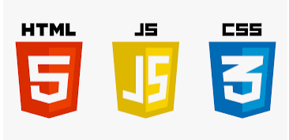




Our Application
Write data from SQLite, and create a class for our data table
Establish two app routes — one home page, and one to jsonify our data
Set up our web page structure and style
Create an interactive dashboard with two visualizations using Chart.js and D3
Read in from CSV and perform initial data manipulation (removing null values, paring down to medal winners, etc.)
Write data to SQLite

Slide 5
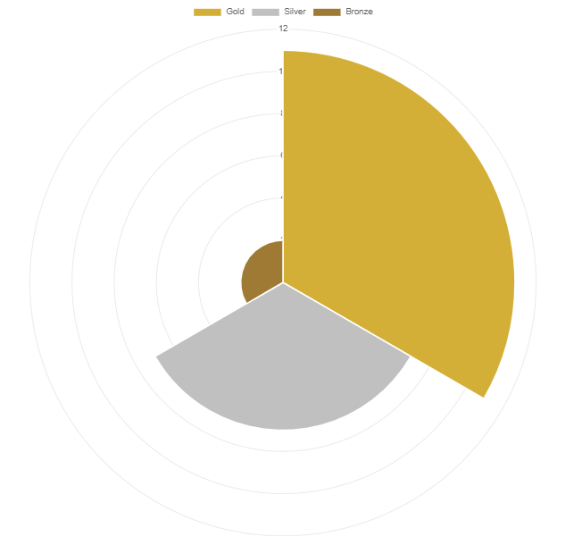
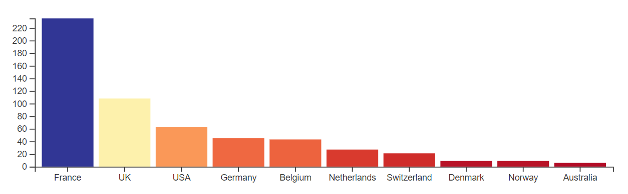
Our Dashboard
D3 Bar Chart
Polar Area Chart
Filter on year of the event
Show top 10 countries by medal counts
Use animation to smoothly transition from one year to the next
Filter on year of the event and country selected
Show medal distribution by gold, silver and bronze
Use chart.js functionality to control animation, etc.

